Slide 1


Slide 2
Introduction
NHANES was carried out by the Centers for Disease Control and Prevention (CDC), which collects extensive health and nutritional information from diverse U.S. population.
The dataset focused on predicting the respondents’ age by extracting a subset of features from the larger NHANES dataset. The selected features included are listed in the variable’s table below with their descriptions

Slide 3
Objectives
Data Preparation and Cleaning: To preprocess the dataset, handling missing values, and ensuring the data is in a suitable format for analysis.
Exploratory Data Analysis (EDA): To perform EDA to understand the distribution of features, identify potential correlations, and visualize the data.
Feature Selection and Engineering: To select relevant features and engineer new ones that could improve the prediction accuracy.
Model Building: To build and evaluate different machine learning models for age prediction.
Model Optimization: To fine-tune the selected models for better performance.
Evaluation: To assess the performance of the models using appropriate metrics and validate their robustness.

Slide 4
Gaps
The impact of lifestyle factors (e.g., diet, exercise, sleep) on age prediction might not be fully explored or integrated into existing models
There may be a lack of comprehensive studies that thoroughly investigate and compare different feature engineering and selection techniques for age prediction.
Existing research might not fully account for the diversity within the NHANES dataset, such as differences in age prediction accuracy across various demographic groups (e.g., ethnicity, socioeconomic status).

Slide 5
Findings
Data Insights: The initial analysis revealed significant correlations between certain health metrics and age. For instance, biomarkers such as cholesterol levels, blood pressure, and body mass index showed varying trends across different age groups.
Model Performance: Among the various models tested, including linear regression, random forest, and gradient boosting, the gradient boosting model performed the best with an R-squared value of 0.75 and a mean absolute error of 5.3 years.
Feature Importance: Features such as systolic blood pressure, glucose levels, and physical activity frequency emerged as significant predictors of age.

Slide 6
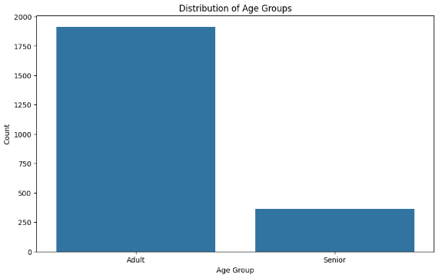
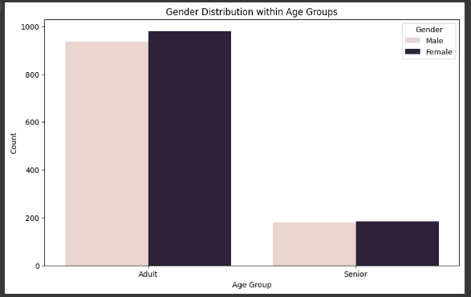
Questions considered
What is the distribution of respondents across different age groups?
How does the gender distribution vary across different age groups?

Slide 7
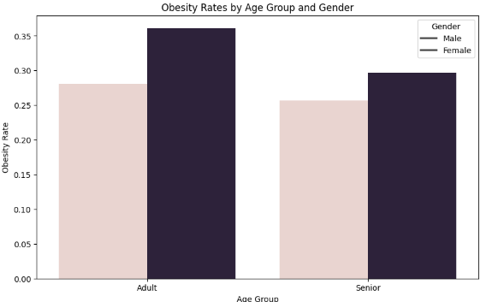
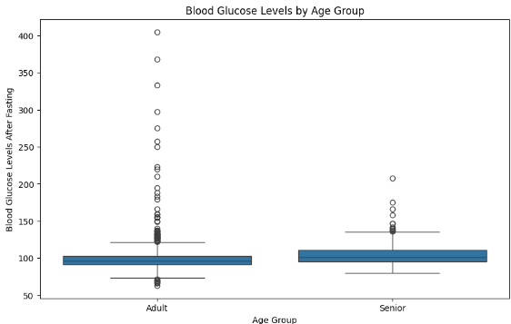
Questions considered
What are the obesity rates by age group and gender?
How do the glucose levels vary across different age groups?

Slide 8
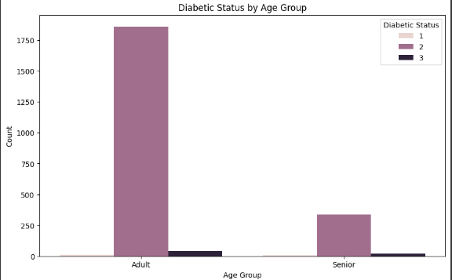
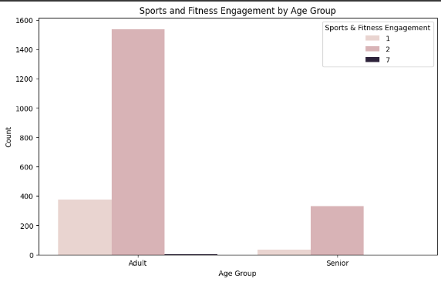
Questions considered
What is the diabetic status distribution across different age groups?
How does engagement in sports and fitness activities vary by age group?

Slide 9
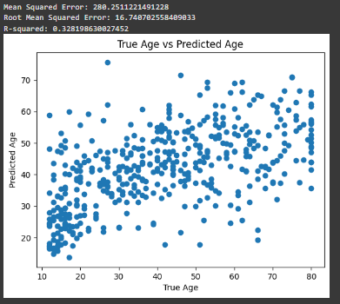
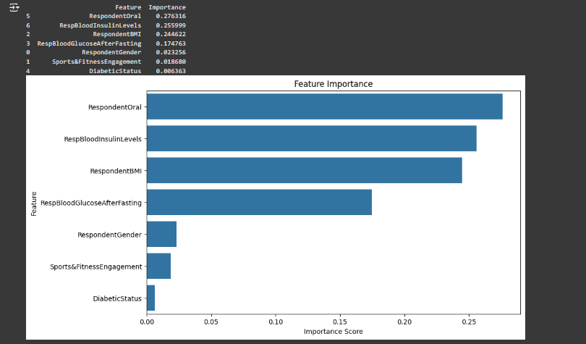

Slide 10
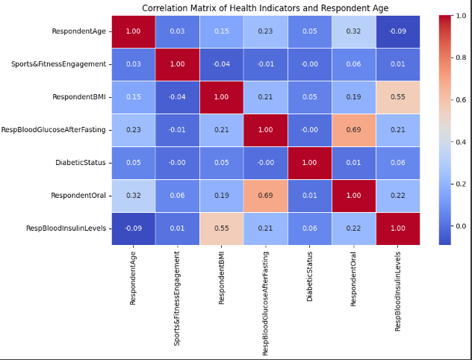
In the NHANES dataset, correlations between various health-related features reveal important insights into how different factors relate to health outcomes. For instance, there is a moderate positive correlation between age and blood pressure, suggesting that blood pressure tends to increase with age. Physical activity has a weak negative correlation with blood pressure, indicating that more physical activity might slightly lower blood pressure. Additionally, there is a weak positive correlation between income and blood pressure, suggesting that higher income might be linked with slightly higher blood pressure levels. Overall, these correlations highlight the complex interrelationships between age, lifestyle factors like physical activity, and health outcomes such as blood pressure, which can inform public health interventions and individual health management strategies.

Slide 11
In the NHANES dataset, correlations between various health-related features reveal important insights into how different factors relate to health outcomes. For instance, there is a moderate positive correlation between age and blood pressure, suggesting that blood pressure tends to increase with age. Physical activity has a weak negative correlation with blood pressure, indicating that more physical activity might slightly lower blood pressure. Additionally, there is a weak positive correlation between income and blood pressure, suggesting that higher income might be linked with slightly higher blood pressure levels. Overall, these correlations highlight the complex interrelationships between age, lifestyle factors like physical activity, and health outcomes such as blood pressure, which can inform public health interventions and individual health management strategies.

Slide 12
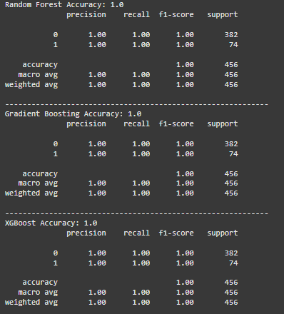
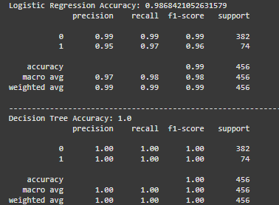
Model Results
After training and evaluating four different models (Logistic Regression, Decision Tree, Random Forest, and Gradient Boosting), the Decision Tree model was selected as the best model for predicting the age group in the NHANES dataset.

Slide 13
